Slide 1
Advanced Algorithms for THz Sensing and Recognition
Murat Torlak and Yiorgos Makris
May 3rd, 2021 Review

Slide 2
Updates
Assisting with Deep Learning
Image Collection for Various Scenarios
1-D Linear Scanning 2-D Imaging
2-D Linear Scanning 2-D Imaging
2-D Linear Scanning 3-D Imaging
Collection of Real Images
Conclusion

Slide 3
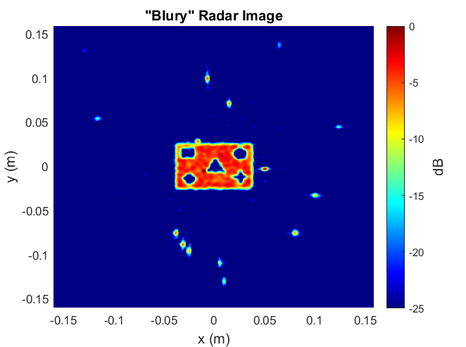

Assisting with Deep Learning
Leverage Sparsity of Ground Truth Image
Input normalization
Zero mean, unit variance – use tanh
Normalize between [0,1] – use ReLU
Last Conv Layer
Depending on normalization, omit “batch normalization” and non-linear activation layer
Output images can be more easily scaled thereby improving convergence

Slide 4
Image Collection for Various Scenarios

Slide 5
1-D Linear Scanning 2-D Imaging
Synthetic array is created along the y-axis.
2-D target in the y-z plane
y – “cross-range axis”
z – “range axis” (depth)

Slide 6
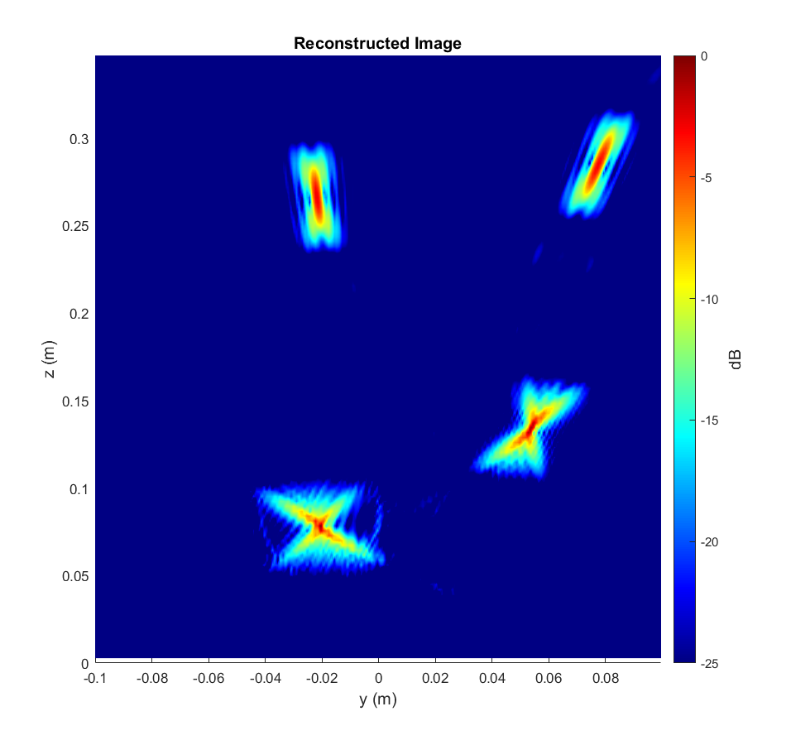
2-D Range vs. Cross-Range Images
SAR Scanning Scenario
Recovered Image

Slide 7
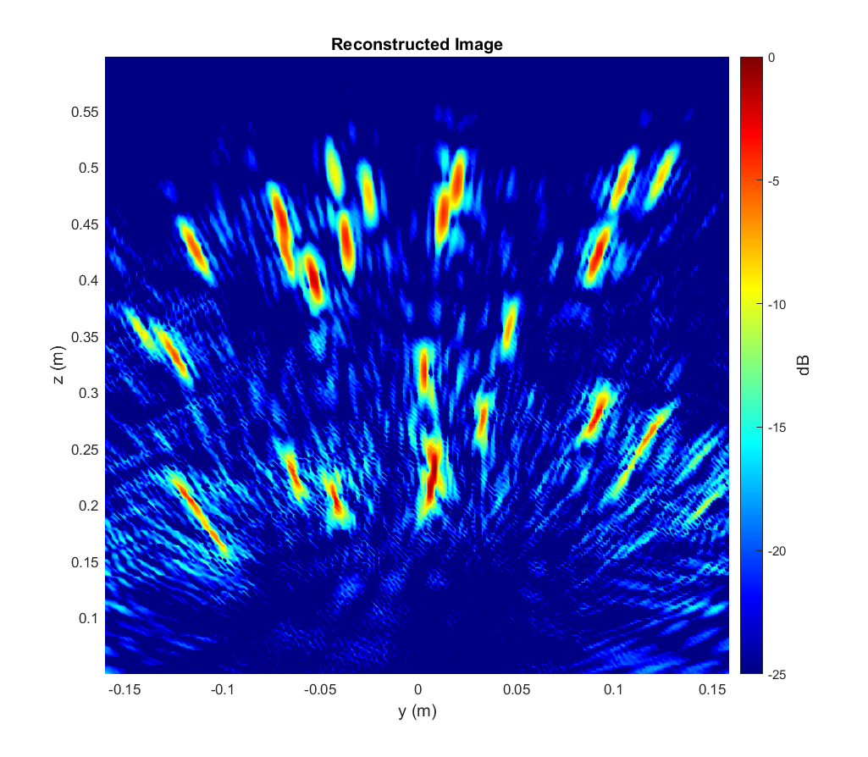
Non-Ideal Imaging Scenario
Antenna Position Errors
Distortion in Recovered Images

Slide 8
Dataset Generation
Generate multiple “synthetic” datasets
Randomly placed points
Number of points randomly varied between samples
Both ideal and non-ideal antenna positions

Slide 9
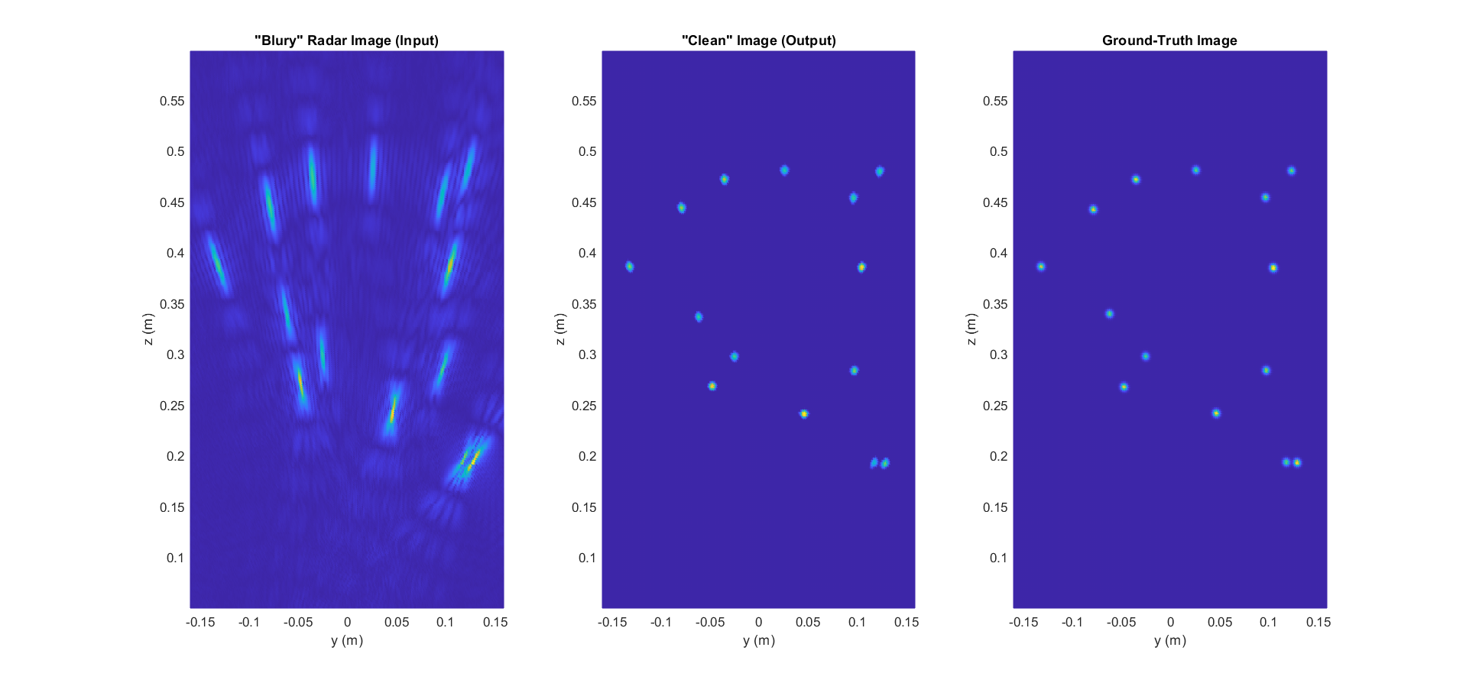
Preliminary Results

Slide 10
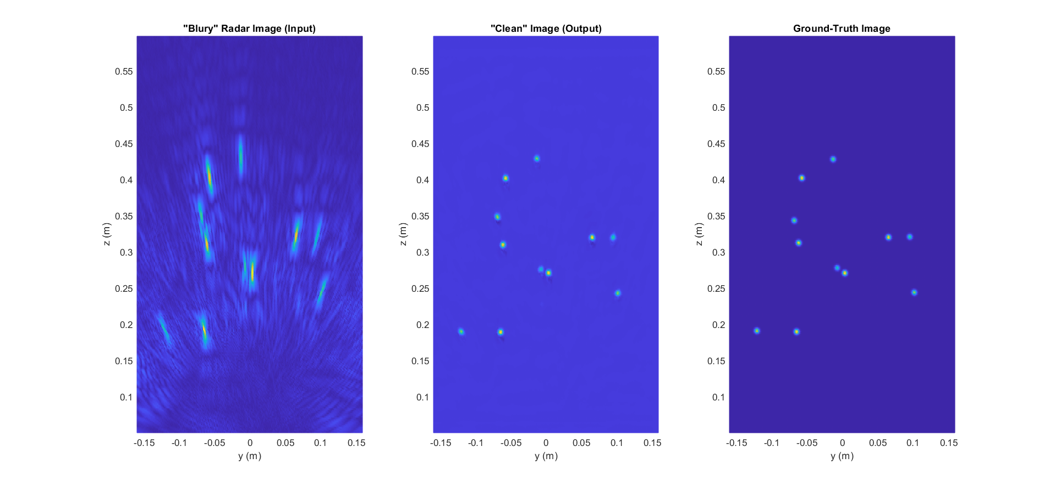
Preliminary Results – Position Errors

Slide 11
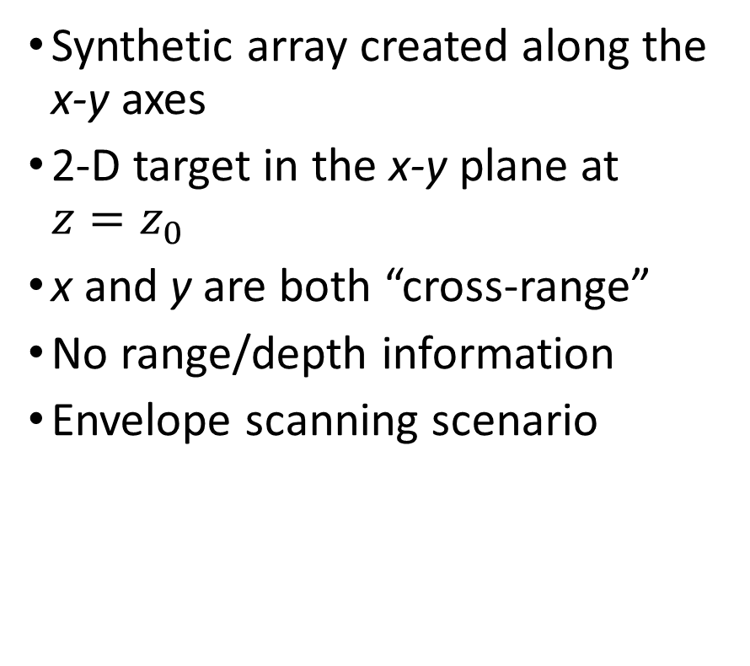
2-D Planar Scanning 2-D Imaging (Envelope)
Synthetic array created along the x-y axes
2-D target in the x-y plane at ${z=z}_{0}$
x and y are both “cross-range”
No range/depth information
Envelope scanning scenario

Slide 12
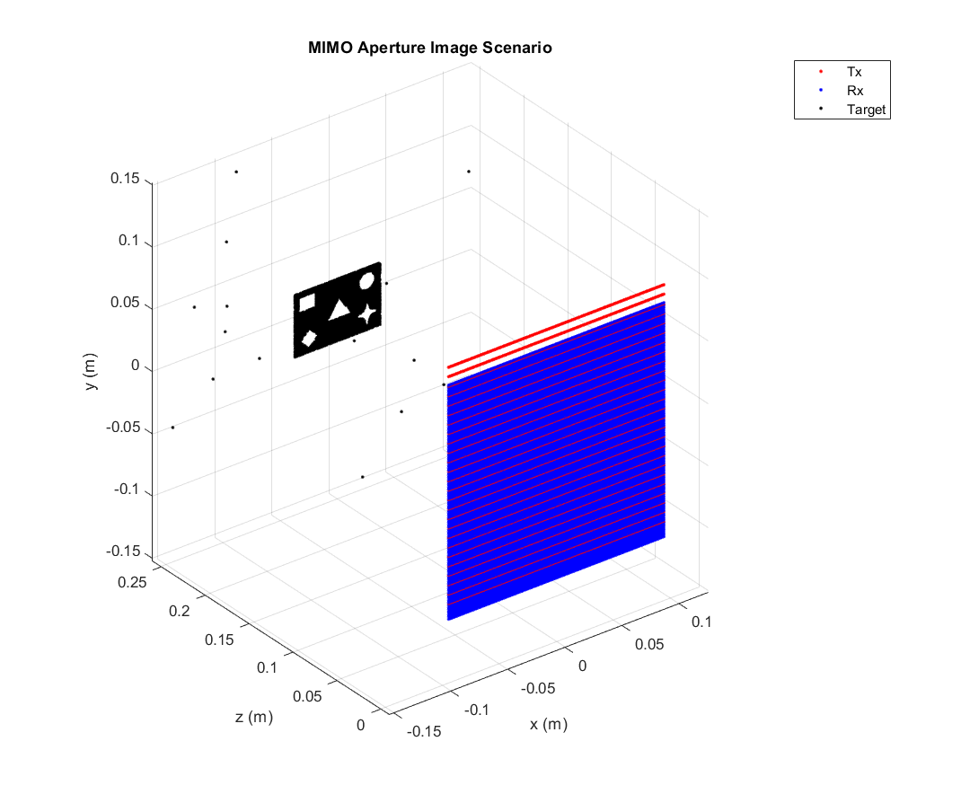
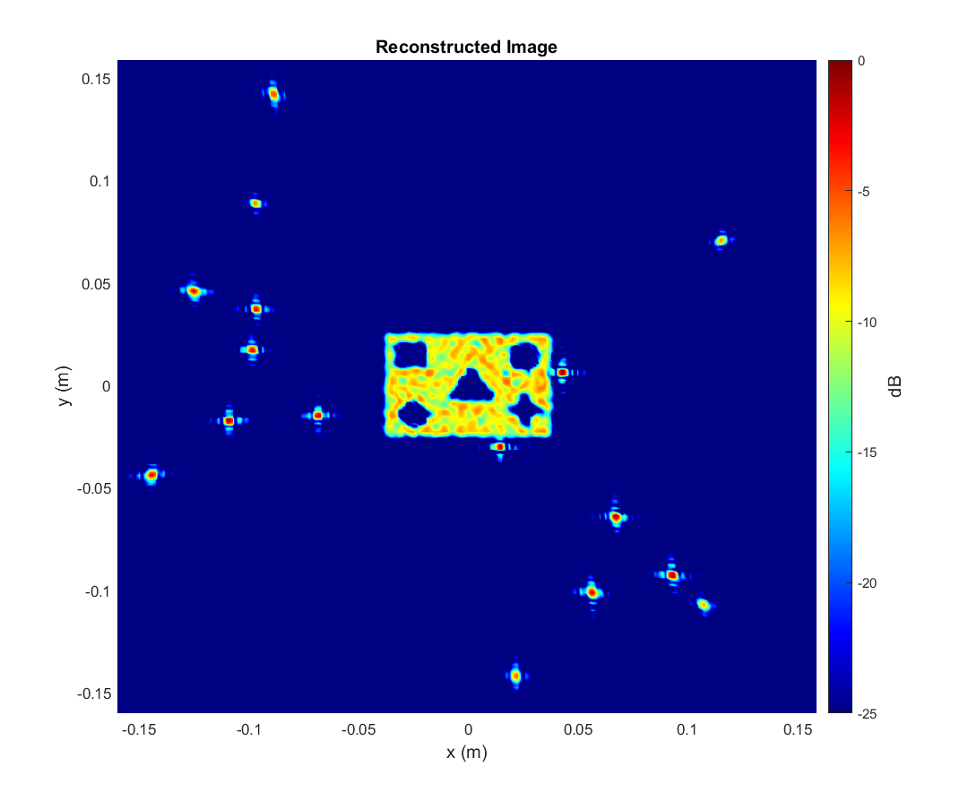
Ideal Imaging Scenario

Slide 13
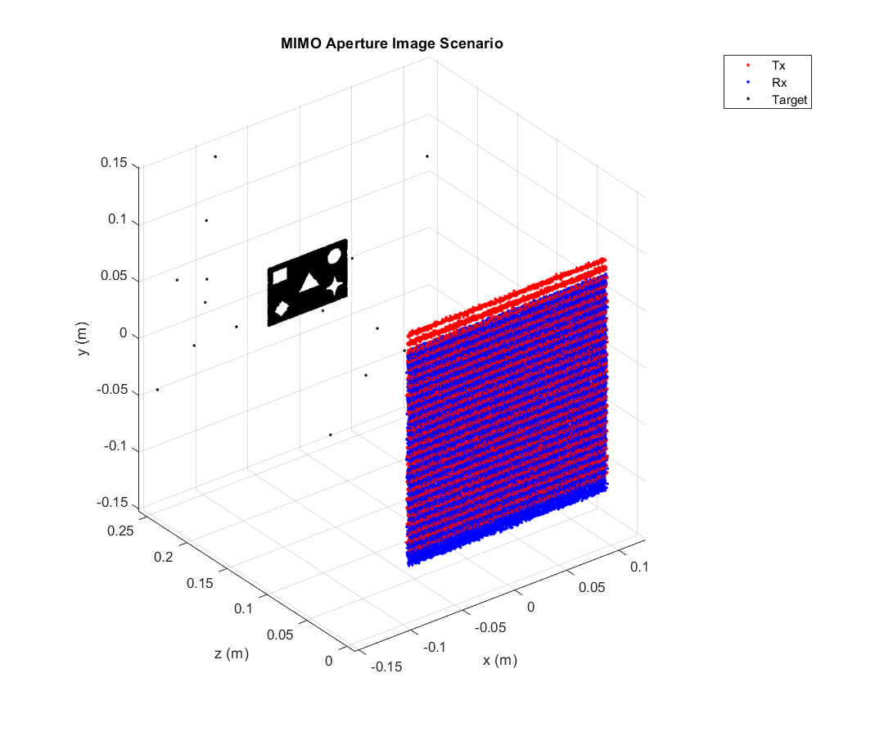
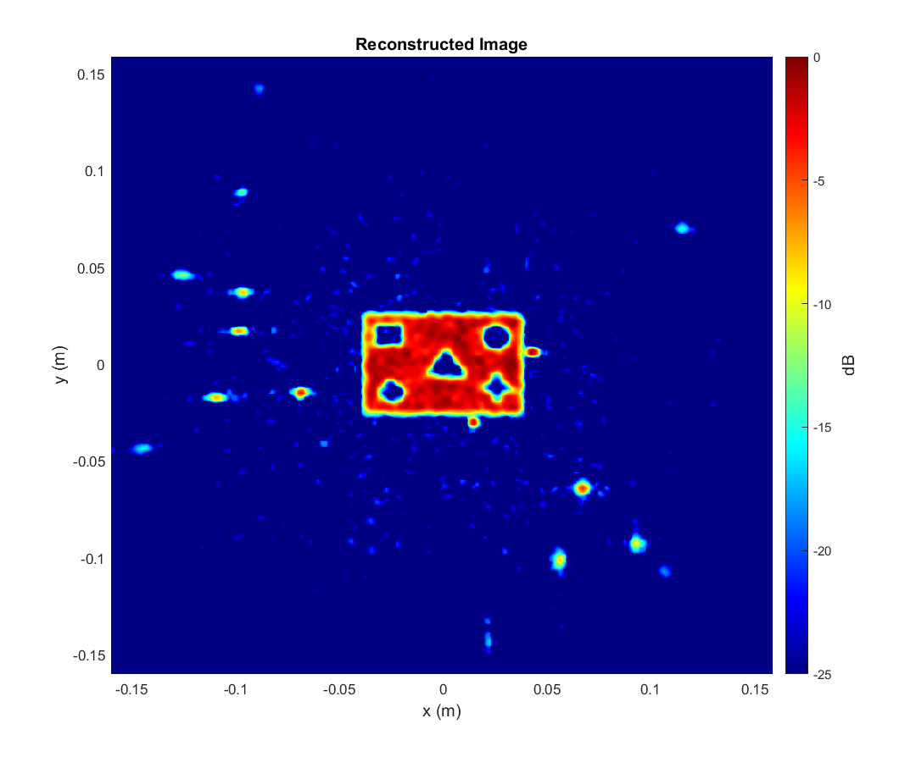
Non-Ideal Imaging Scenario

Slide 14
Dataset Generation
Generate multiple “synthetic” datasets
Randomly placed points
Number of points randomly varied between samples
Solid targets (cutout or random shapes)
Randomly placed
Randomly sized
Both ideal and non-ideal antenna positions

Slide 15
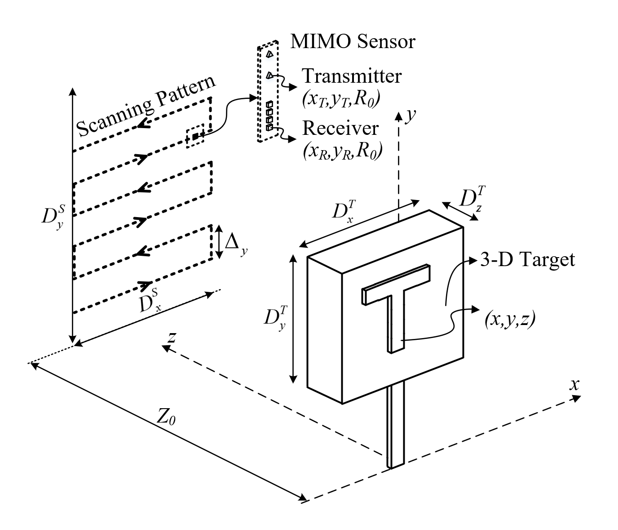
2-D Planar Scanning 3-D Imaging (Box Scanning)
Synthetic array created along the x-y axes
3-D target in the x-y-z space
x and y are both “cross-range”
z – “range axis”
Depth is now included, at the cost of an added dimensionality of complexity

Slide 16
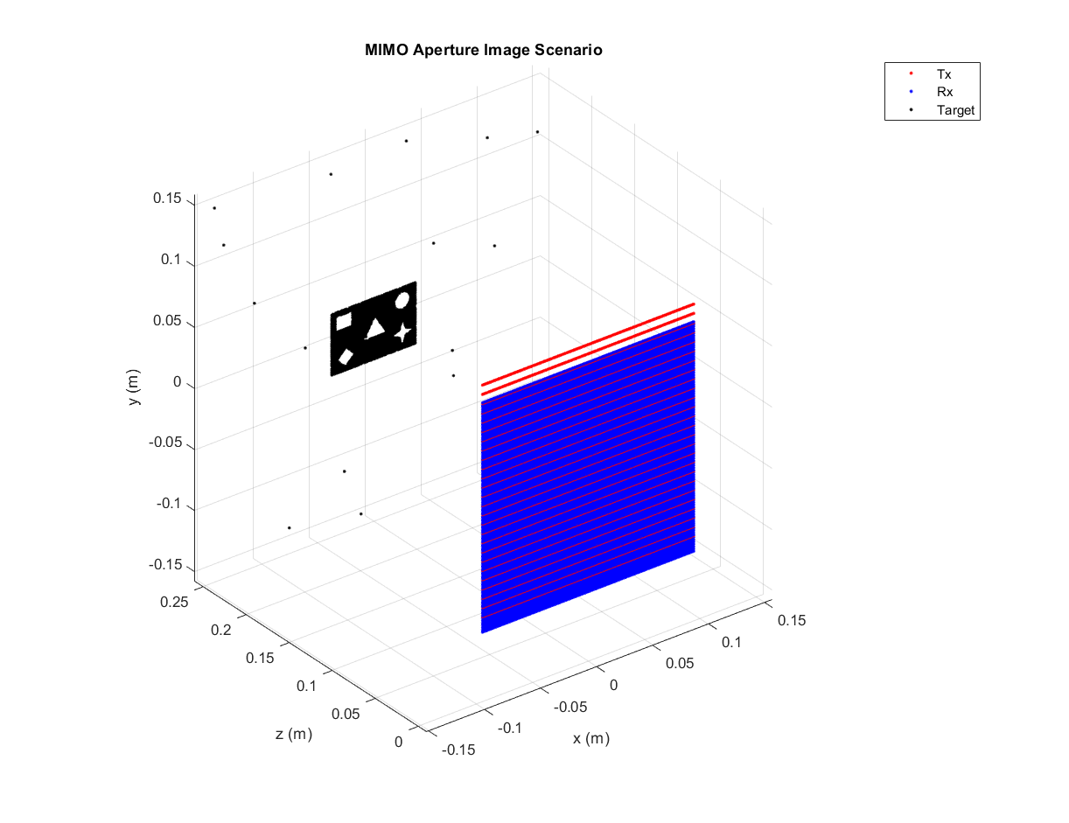
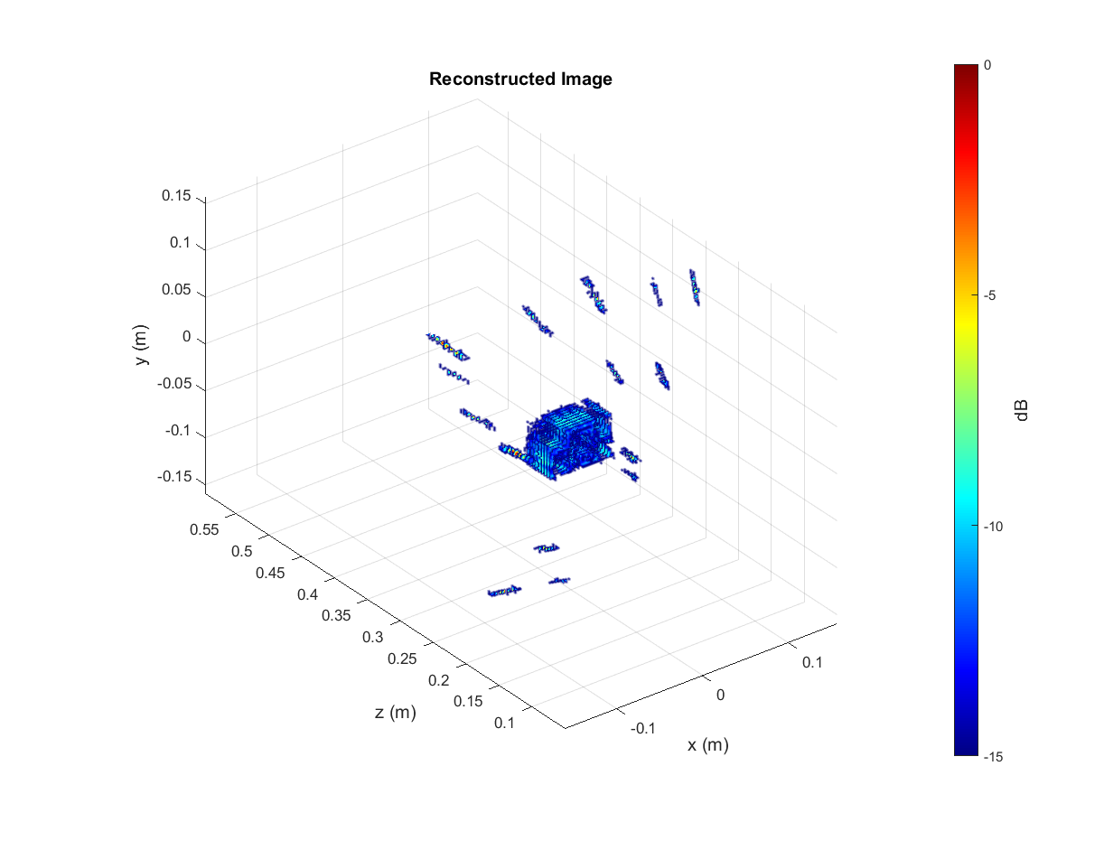
Ideal Imaging Scenario

Slide 17
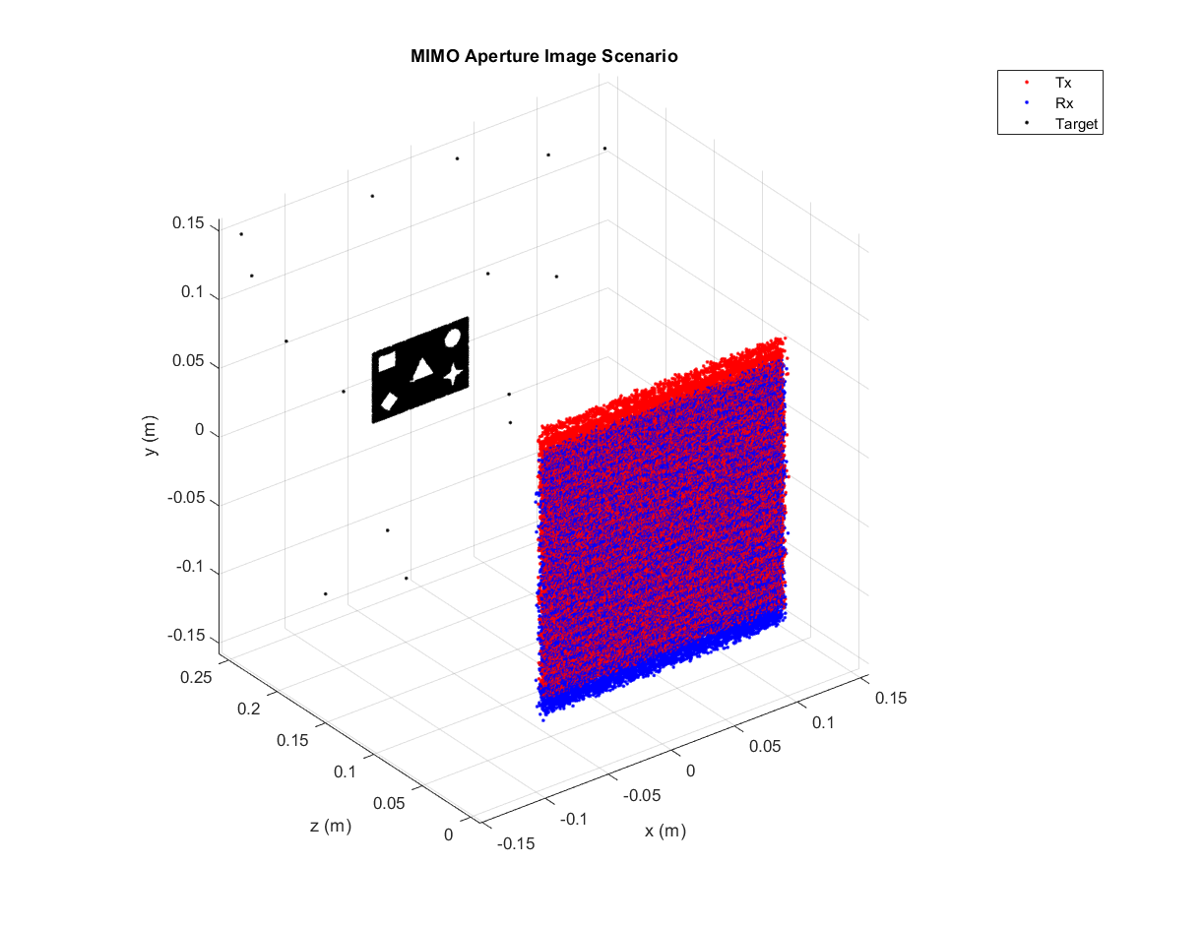
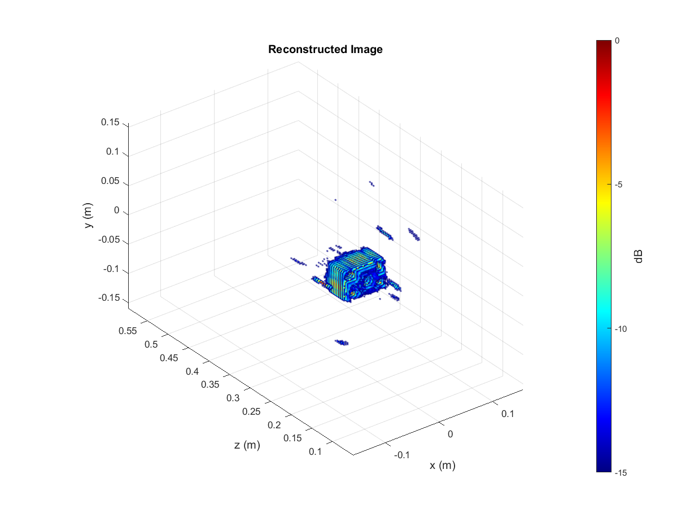
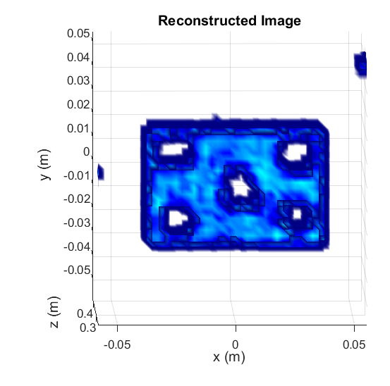
Non-Ideal Imaging Scenario
Shapes lost definition
Notes:
2048

Slide 18
Dataset Generation
Generate multiple “synthetic” datasets
Randomly placed points
Number of points randomly varied between samples
Solid targets (cutout or random shapes)
Randomly placed
Randomly sized
Both ideal and non-ideal antenna positions
Constructing a “real” dataset

Slide 19
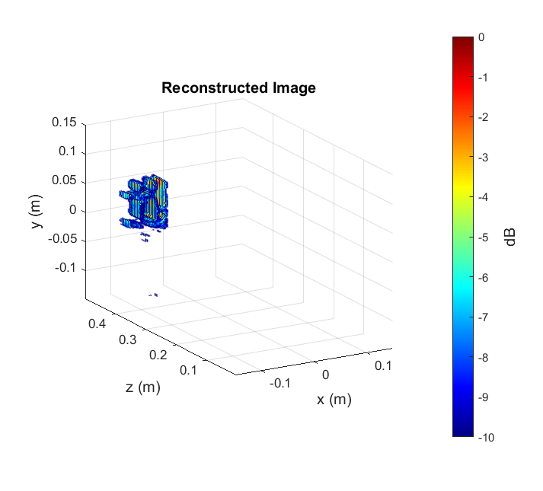
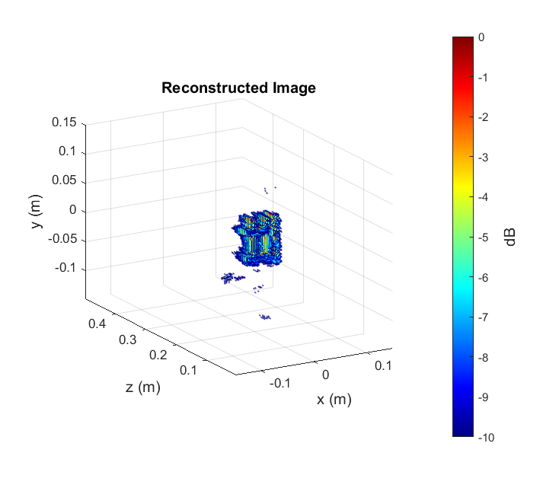
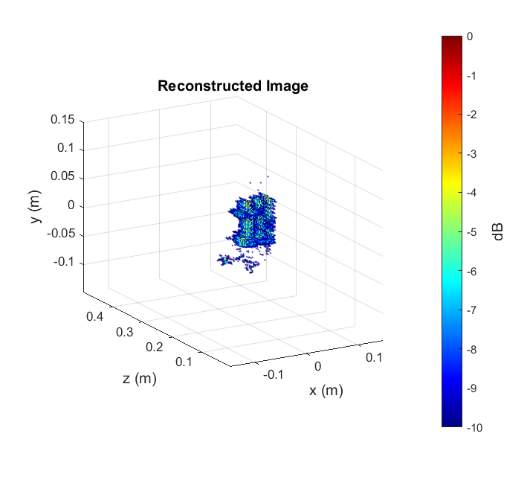
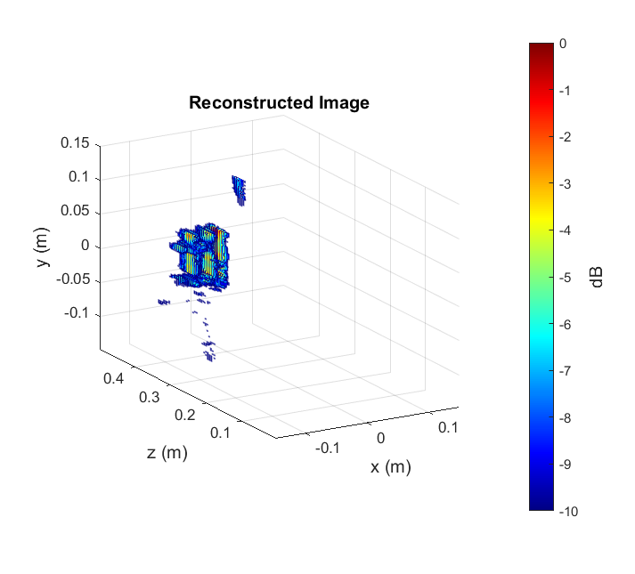
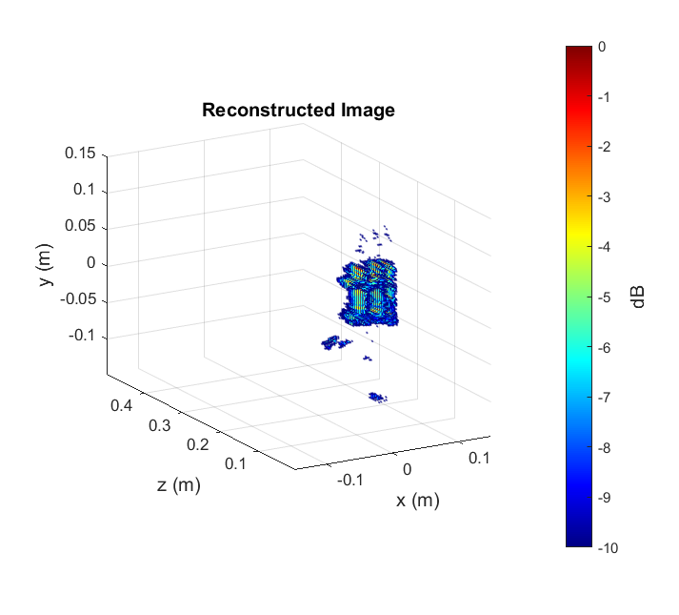
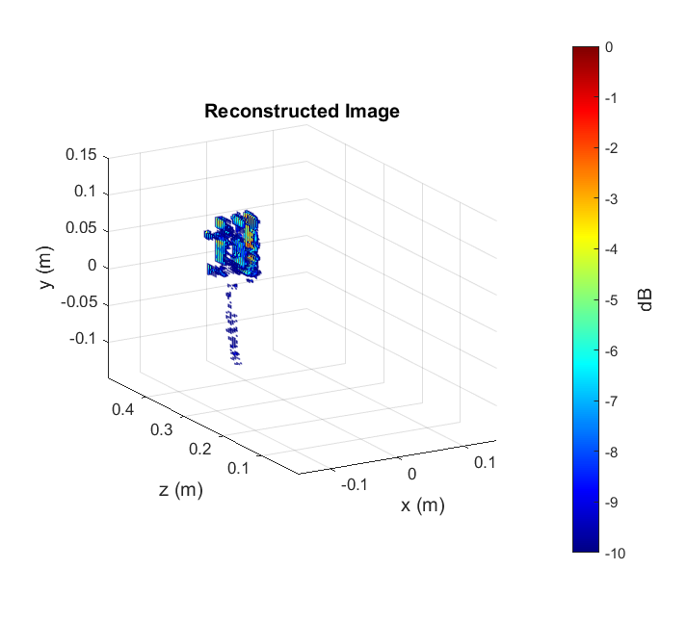
Real Image Dataset
Envelope Scenario
Can be used for either 2-D or 3-D imaging
Cutout in multiple positions
Can supplement the synthetic data to improve the training quality

Slide 20
Conclusions
Continue synergy towards resolution-improving network architectures
Software pipeline in place for simulating large, meaningful datasets
Consider position-error imaging after optimizing ideal case
Collecting real data to supplement synthetic training sets

